Slide 1
Image Enhancement
  The process of manipulating the image so that the result is more suitable than the original for specific applications
  Techniques of Image Enhancement
  Spatial Domain – involves direct modification of pixels.
  Frequency Domain – involves modification of the Fourier transformation of an image
  Combination – involves a combination of spatial and frequency domains

Slide 2
Image Enhancement - Spatial Domain
Operations happen on the pixels (x, y) of the image itself.
The transformation function has been given below
s = T ( r )
where r is the pixels of the input image and s is the pixels of the output image. T is a transformation function that maps each value of r to each value of s.

Slide 3
Image Enhancement - Spatial Domain
Common Techniques
Gray-Level Transformations
Histogram Processing
Spatial Filtering (Neighborhood Operations)

Slide 4
Gray-Level Transformations - Linear
There are three basic Gray-Level Transformations
Linear transformations
Logarithmic transformations
Power-Law(Gamma) transformations
Adjusts pixel intensity correcting how human eyes and devices perceive brightness differently than linear sensors, enhancing contrast by expanding dark or compressing bright areas.

Slide 5
Linear transformation includes
Simple identity transition
Negative transformation

Slide 6
Identity transition is shown by a straight line. In this transition, each value of the input image is directly mapped to each other value of output image. That results in the same input image and output image. And hence is called identity transformation. It has been shown below:

Slide 7
The transformation can be described by a simple function 𝑇, where for every input pixel value 𝑟
the output pixel value 𝑠 is 𝑠=𝑇(𝑟) and specifically, 𝑇(𝑟)=𝑟.
This transformation is useful when you want to preserve the original appearance of the image without altering its intensity characteristics.

Slide 8
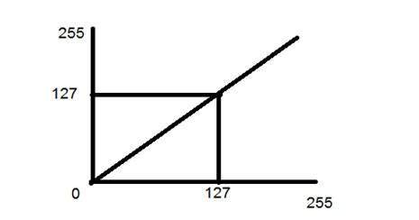
Identity transformation is shown by a straight line.

Slide 9
Negative transformation
The second linear transformation is negative transformation, which is invert of identity transformation. In negative transformation, each value of the input image is subtracted from the L-1 and mapped onto the output image.
Formula: 𝑠=𝐿−1−𝑟
(where 'r' is original intensity, 's' is new, and 'L' is total levels, e.g., 256 for 8-bit), which enhances details in dark areas and is vital in medical imaging like X-rays.

Slide 10
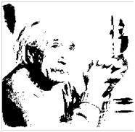
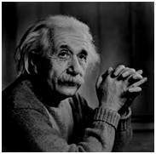
The result is somewhat like this.
INPUT IMAGE
OUTPUT IMAGE

Slide 11
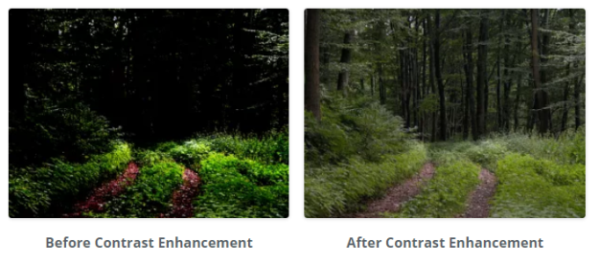
Gray-Level Transformations - LOGARITHMIC

Slide 12
Gray-Level Transformations - LOGARITHMIC
The log transformation is of the form:
s = T(r) = c log (1 + r)
where
r is input pixel intensity
s is output pixel intensity
c is scaling constant
+1 is added to the input to handle pixel values of zero, preventing infinite logarithm values.

Slide 13
Using c=1 provides basic transformation.
c log(1 + r) scales the output to the full dynamic range ensuing optimal use of available gray levels.
Original Image (Limited Range): Imagine a photo where most pixels are in the mid-gray range (like 30-70), so darks aren't very dark, and lights aren't very bright.
Scaling to Full Range: This process takes those mid-gray values and spreads them out, pushing the darkest original pixel to black (0) and the brightest to white (255), and redistributing all shades in between.
Result (Optimal Use): You get better contrast, revealing details in shadows and highlights that were previously lost in the "middle," making the image look richer and more detailed.

Slide 14
Expanding Darks – Enhances dark image regions by expanding their details(low intensities) while compressing bright areas improving visual quality when contrast is poor.
Compressing Brights –
Large changes in high input intensity values(r) are mapped to a much smaller range of output values(s). This "compresses" the tonal range(spectrum of brightness levels, from the darkest shadows to the brightest highlights, within an image) of the bright areas.

Slide 15
Application:
Image Enhancement: Makes dark regions of an image brighter, improving visibility of details that are otherwise lost in shadows, such as facial features or subtle textures.
Low-Light Images: It is effective for enhancing details in dark images or underexposed photographs where significant information is hidden in the low pixel values.
.

Slide 16
Dynamic Range Compression:
Reduces the vast range of pixel values in high-contrast images (like those with very bright skies and dark foregrounds) into a more manageable range, preventing clipping(losing detail in the brightest part in the image resulting in white areas where no data to recover).
Dynamic range refers to the ratio of max and min intensity values. When the dynamic range of the image is greater than that of displaying device, the lower values are suppressed. To overcome this issue, we use log transform. Log transformation first compresses the dynamic range and then upscales the image to a dynamic range of the display device. In this way, lower values are enhanced and thus the image shows significantly more details.

Slide 17
Satellite and Arial Imaging: Improves the visual quality of terrains and objects in images captured from space or aircraft, where lighting conditions vary greatly.
Medical Image Scanning: Enhances contrast in X-rays, CT scans, and MRI images, highlighting subtle tissue differences.

Slide 18
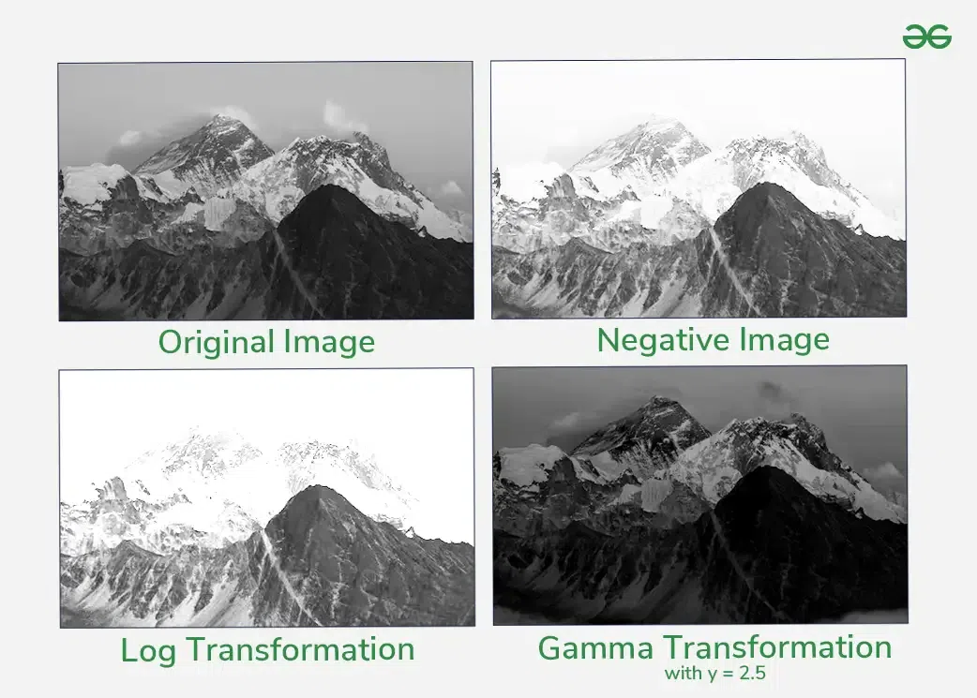

Slide 19
Log gone wrong - if most of the details are present in the high pixel values, then applying the log transform results in the loss of information

Slide 20

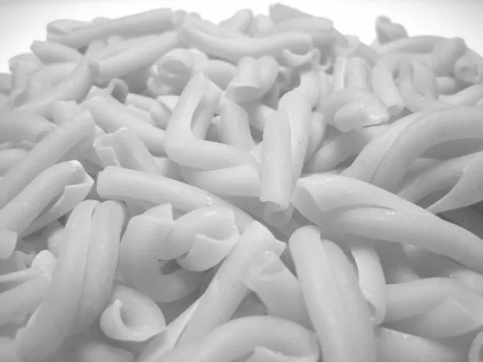
AFTER
BEFORE

Slide 21
Negative Vs Log
Negative inverts the image (enhancing dark details)
Log expands darks while compressing brights i.e maps a narrow range of low-intensity values in the input image to a much wider range of output levels (great for low-contrast, high-dynamic-range images)

